Slide 1
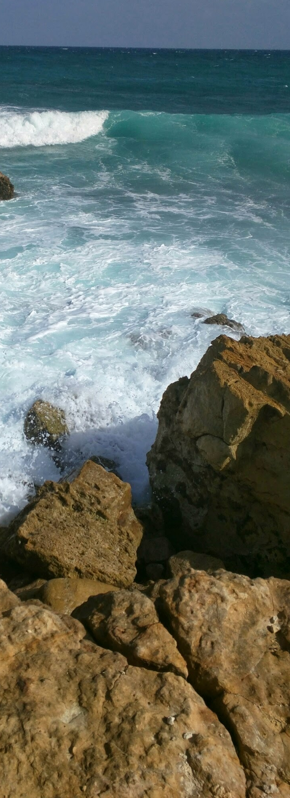


TRAVEL BOOKING SYSTEM
GROUP NUMBER:- 93

Slide 2

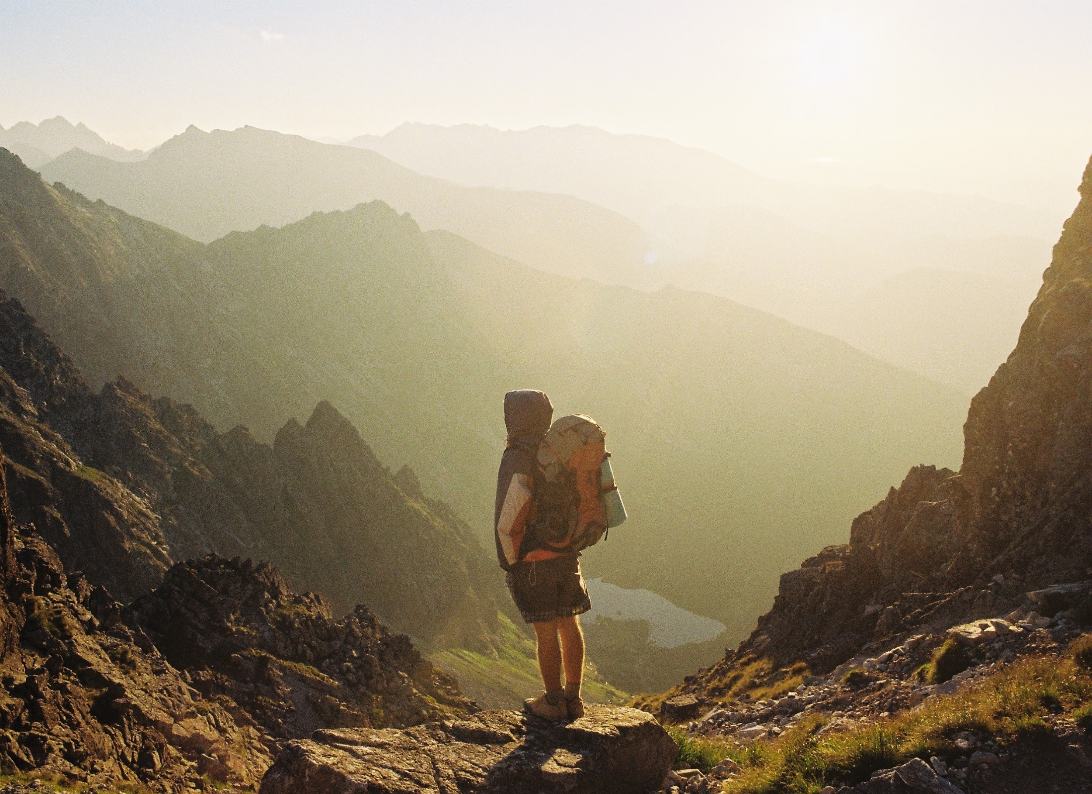
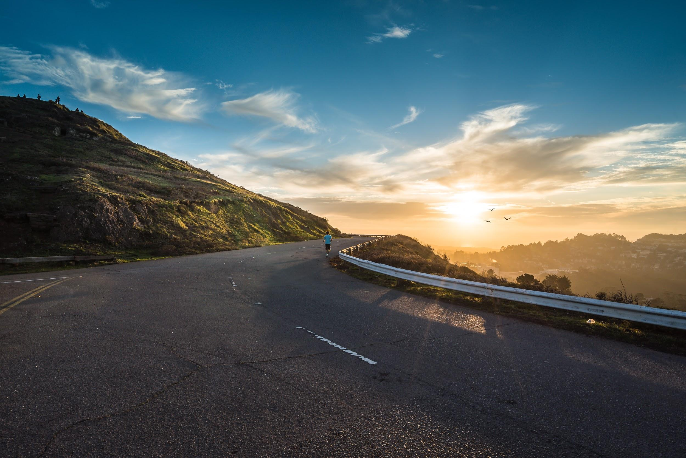
Features of the Travel booking system:-
Shall be able to signup and signin to the mobile application.
Shall be able to buy rent and sell travelling related products.
Shall be able to book a hotel.
Shall be able to book a vehicle.
Shall be able to do online payments.
Shall be able to add hotel information.

Slide 3
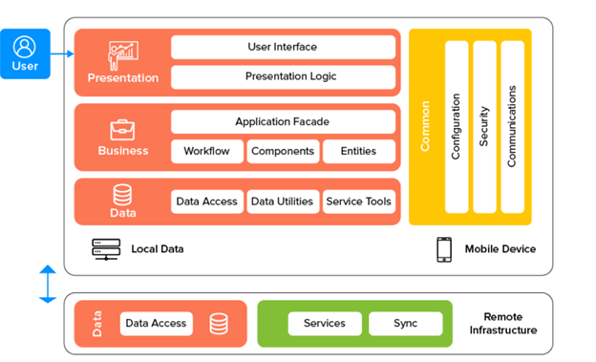
High level architechture diagram.

Slide 4

Member 1 - 10707362 (S. H. N. Sanjula){Vehichle Booking}
User can book vehicles such as three wheelers and cars or vans for travelling.
What programming languages and tools we are using?
Programming Languages.
Dart xml
Tools.
Android Studio & Intellij
Flutter SDK
Hot reload
Code formatting

Slide 5
Member 2 - 10707193 (R. J. D. Fernando){Hotel Booking }
Travelers can book hotels.
Can make online payments through debit or credit cards.
Travelers can checking or checkout using the hotel booking.
Programming Languages.
Dart xml
Tools.
Android Studio & Intellij
Flutter SDK
Hot reload
Code formatting

Slide 6
Member 3 - 10707375 (B. P. P. Silva){Travelling Sites}
Travelers can see local tourist attractions.
Travelers can share their experience.
Travelers can upload photoes.
Programming Languages.
Dart xml
Tools.
Android Studio & Intellij
Flutter SDK
Hot reload
Code formatting

Slide 7

Member 4 - 10707202 (Sasindu Gamage) {Travelling Items}
Travelers can buy or rent traveling items such as,
Backpacks.
Camping tents.
Cooking accessories.
Travelers can do online payment through the app.
Programming Languages.
Dart xml
Tools.
Android Studio & Intellij
Flutter SDK
Hot reload
Code formatting

Slide 8
Member 5 - 10707428 (R. P. Yasiru) {Resturants}
Travelers can see the locations of the restaurants islandwide..
Travelers can rate the restaurants .
Travelers can write reviews about the restaurant.
Programming Languages.
Dart xml
Tools.
Android Studio & Intellij
Flutter SDK
Hot reload
Code formatting

Slide 9
Member 6 - 10707297 (G. S. M. Pathirana) {Vehichles Rent}
Travelers can rent motorcycles, cars, jeeps or three wheelers.
Travelers can rate the vehicles renting company.
Programming Languages.
Dart xml
Tools.
Android Studio & Intellij
Flutter SDK
Hot reload
Code formatting

Slide 10
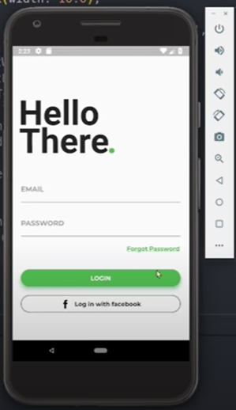
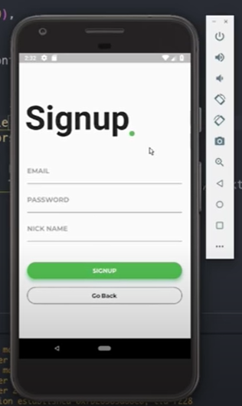
SCREENSHOTS OF THE SYSTEM

Slide 11


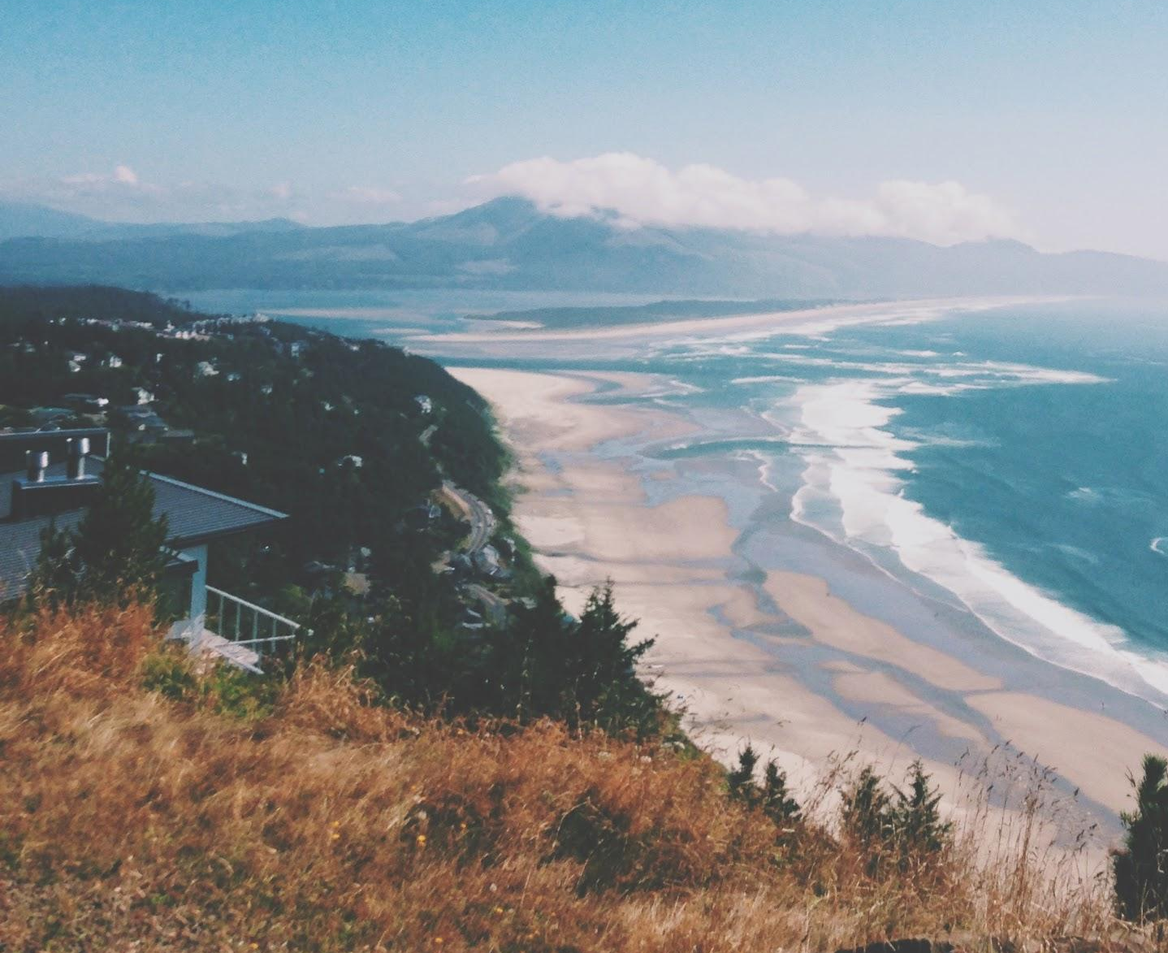


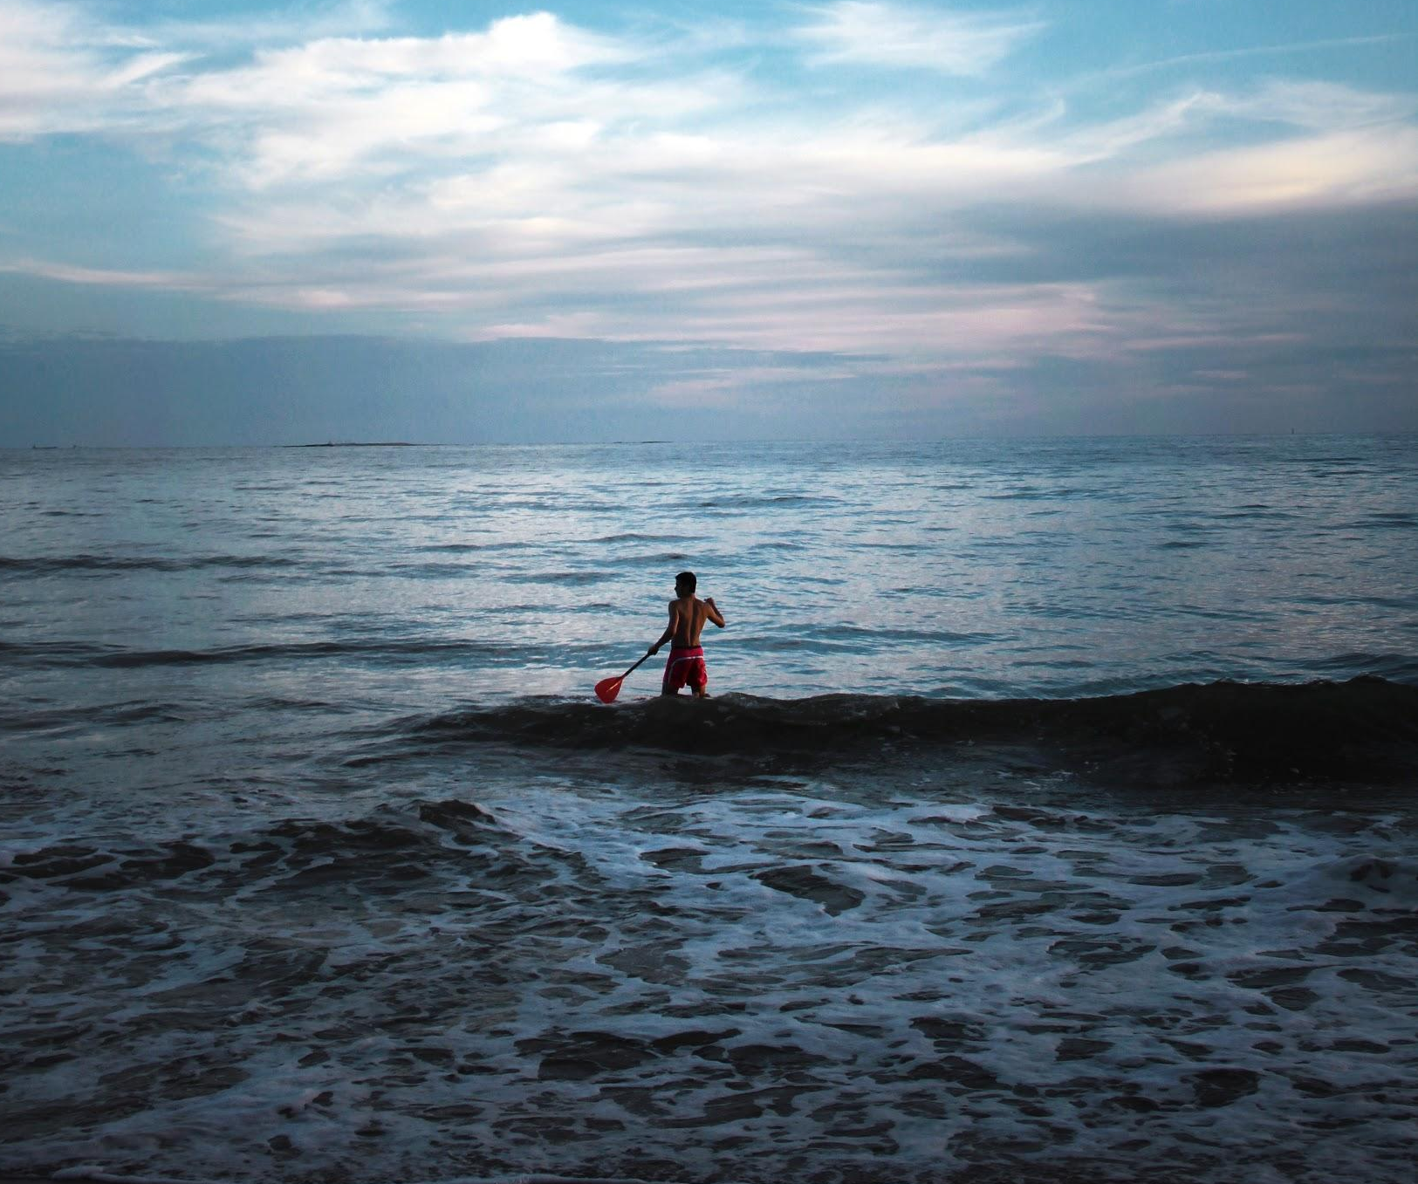
10707362 Saunda Sanjula
10707193 Ruhunu Fernando
10707375 Balage Silva
10707202 Sasindu Gamage
10707428 Ran Yasiru
10707297 Godalla Pathirana

Slide 12
Thank You!

